Slide 1
Image Segmentation
邸慧军
ajon@bit.edu.cn
计算机学院
智能信息技术北京市重点实验室
图像计算与感知智能研究所

Slide 2
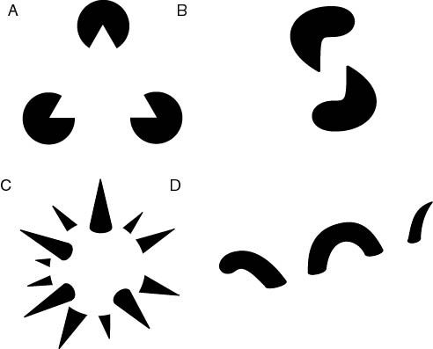
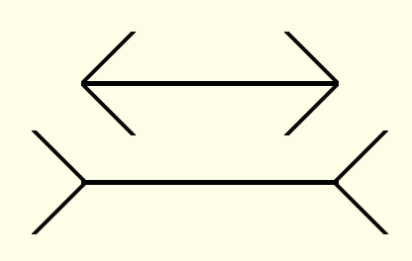
Psychology: The Gestalt school
The Gestalt school: Grouping is key to visual perception
The Muller-Lyer illusion
Elements in a collection can have properties that result from relationships
http://en.wikipedia.org/wiki/Gestalt_psychology

Slide 3
Content
Introduction
Granularity/Hierarchy
The Goals of Segmentation
Segmentation by Thresholding
Region-Based Segmentation
Watershed Segmentation
Segmentation as Clustering
Discontinuity-based Method
Semantic Segmentation

Slide 4
Introduction to image segmentation
The purpose of image segmentation is to partition an image into meaningful regions with respect to a particular application
The segmentation is based on measurements taken from the image and might be greylevel, colour, texture, depth or motion

Slide 5
Introduction to image segmentation
Usually image segmentation is an initial and vital step in a series of processes aimed at overall image understanding
Applications of image segmentation include
Identifying objects in a scene for object-based measurements such as size and shape
Identifying objects in a moving scene for object-based video compression (MPEG4)
Identifying objects which are at different distances from a sensor using depth measurements from a laser range finder enabling path planning for a mobile robots

Slide 6
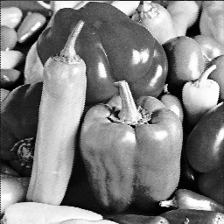

Introduction to image segmentation
Example 1
Segmentation based on greyscale
Very simple ‘model’ of greyscale leads to inaccuracies in object labelling

Slide 7
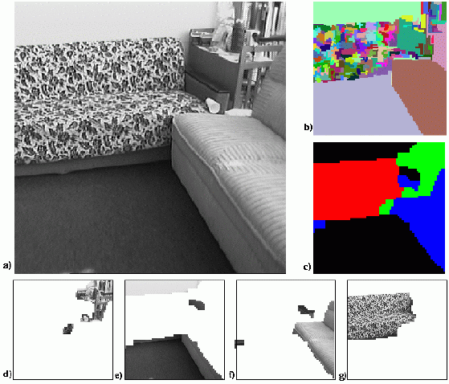
Introduction to image segmentation
Example 2
Segmentation based on texture

Slide 8
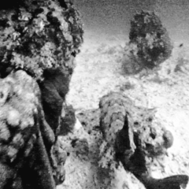

Introduction to image segmentation
Example 3
Segmentation based on motion
The main difficulty of motion segmentation is that an intermediate step is required to (either implicitly or explicitly) estimate an optical flow field

Slide 9
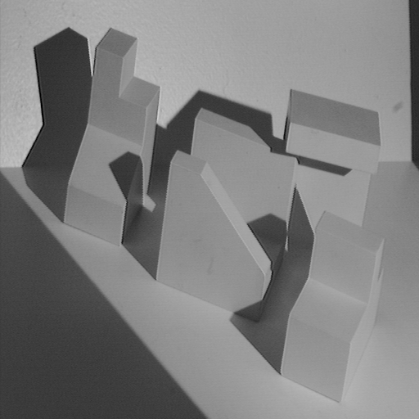
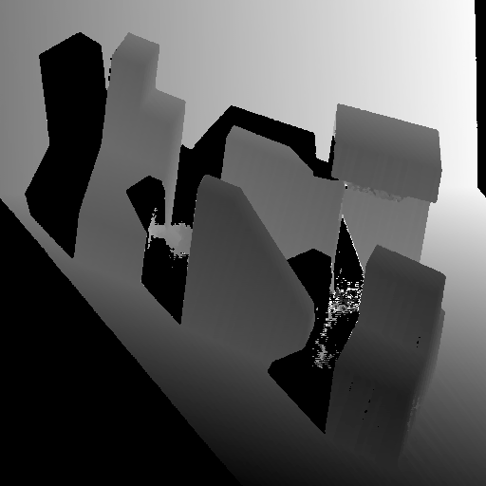
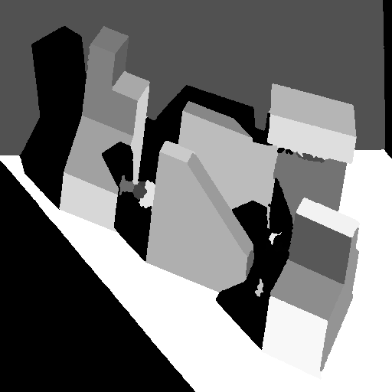
Introduction to image segmentation
Example 4
Segmentation based on depth
This example shows a range image, obtained with a laser range finder
Original image
Range image
Segmented image

Slide 10
Content
Introduction
Granularity/Hierarchy
The Goals of Segmentation
Segmentation by Thresholding
Region-Based Segmentation
Watershed Segmentation
Segmentation as Clustering
Discontinuity-based Method
Semantic Segmentation

Slide 11
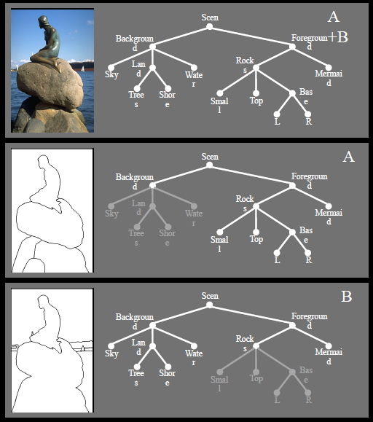
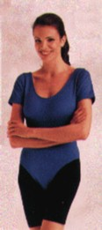


Granularity/Hierarchy
input
result 1
result 2
What do we mean by “DIFFERENT” objects?
Another example: when we look at trees at a close distance, we consider
each of them as a different object; but as we look at trees far away, they
merge into one coherent object (woods)

Slide 12
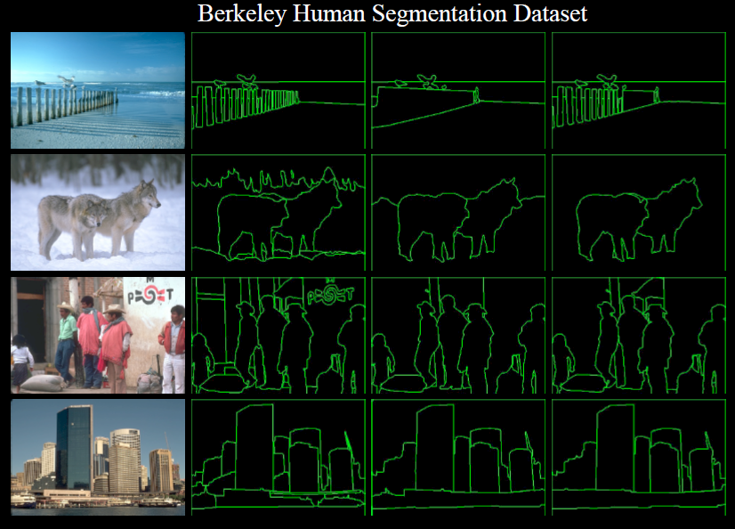

Slide 13
Content
Introduction
Granularity/Hierarchy
The Goals of Segmentation
Segmentation by Thresholding
Region-Based Segmentation
Watershed Segmentation
Segmentation as Clustering
Discontinuity-based Method
Semantic Segmentation

Slide 14

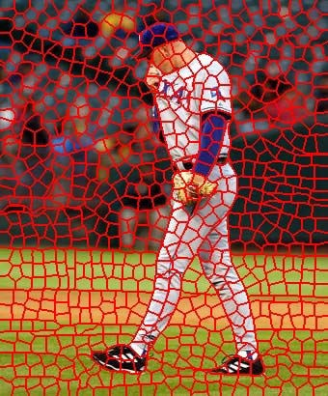
The goals of segmentation
Group together similar-looking pixels for efficiency of further processing
“Bottom-up” process
Unsupervised
“superpixels”
X. Ren and J. Malik. Learning a classification model for segmentation.
ICCV 2003.

Slide 15
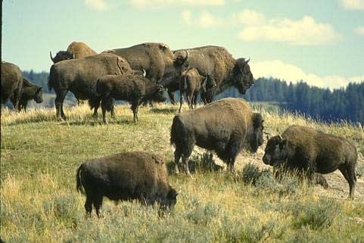
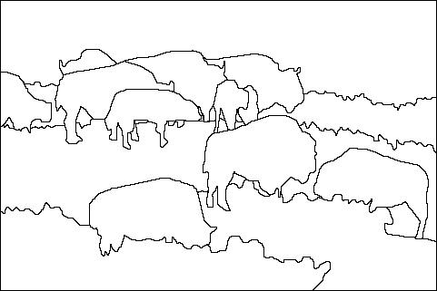

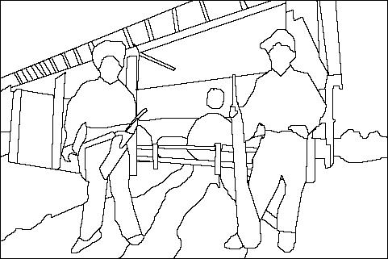
The goals of segmentation
Separate image into coherent “objects”
“Bottom-up” or “top-down” process?
Supervised or unsupervised?
image
human segmentation
Berkeley segmentation database:
http://www.eecs.berkeley.edu/Research/Projects/CS/vision/grouping/segbench/

Slide 16
Content
Introduction
Granularity/Hierarchy
The Goals of Segmentation
Segmentation by Thresholding
Region-Based Segmentation
Watershed Segmentation
Segmentation as Clustering
Discontinuity-based Method
Semantic Segmentation

Slide 17
Segmentation by Thresholding
Suppose that the gray-level histogram corresponds to an image f(x,y) composed of dark objects on the light background, in such a way that object and background pixels have gray levels grouped into two dominant modes. One obvious way to extract the objects from the background is to select a threshold ‘T’ that separates these modes.
Then any point (x,y) for which f(x,y) < T is called an object point, otherwise, the point is called a background point.

Slide 18
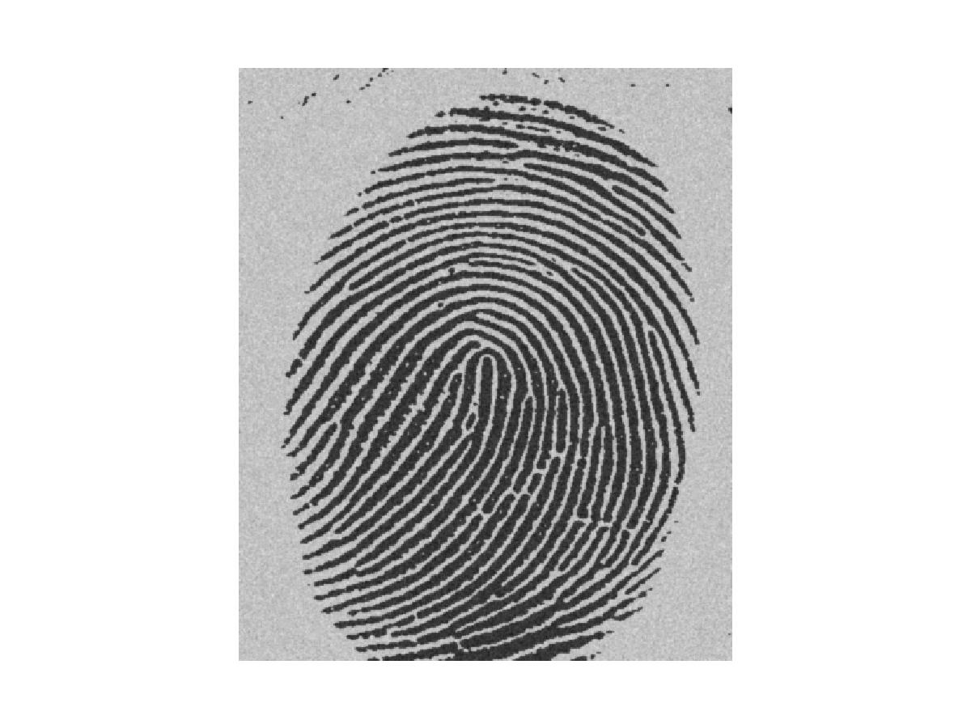
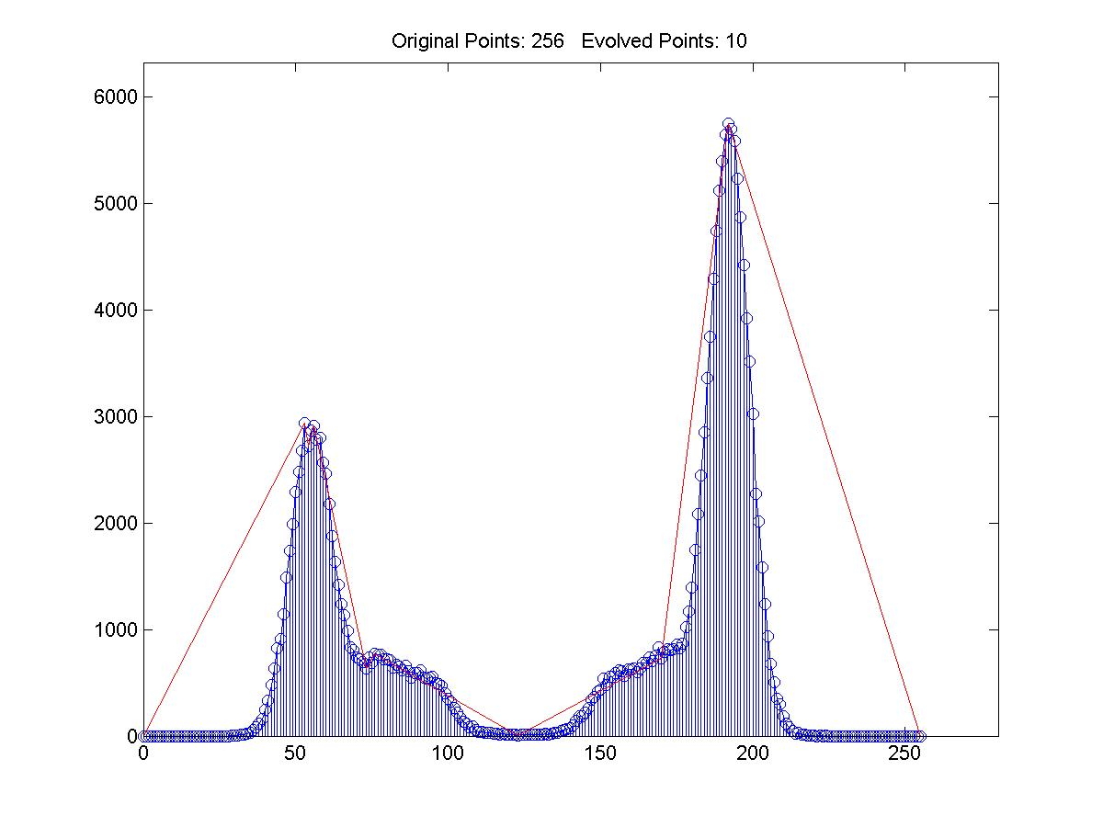
Segmentation by Thresholding

Slide 19

Segmented Image
Image after Segmentation

Slide 20
Thresholding Bimodal Histograms
Basic Global Thresholding:
1)Select an initial estimate for T
2)Segment the image using T. This will produce two groups of pixels. G1 consisting of all pixels with gray level values >T and G2 consisting of pixels with values <=T.
3)Compute the average gray level values mean1 and mean2 for the pixels in regions G1 and G2.
4)Compute a new threshold value
T=(1/2)(mean1 +mean2)
5)Repeat steps 2 through 4 until difference in T in successive iterations is smaller than a predefined parameter T0.

Slide 21
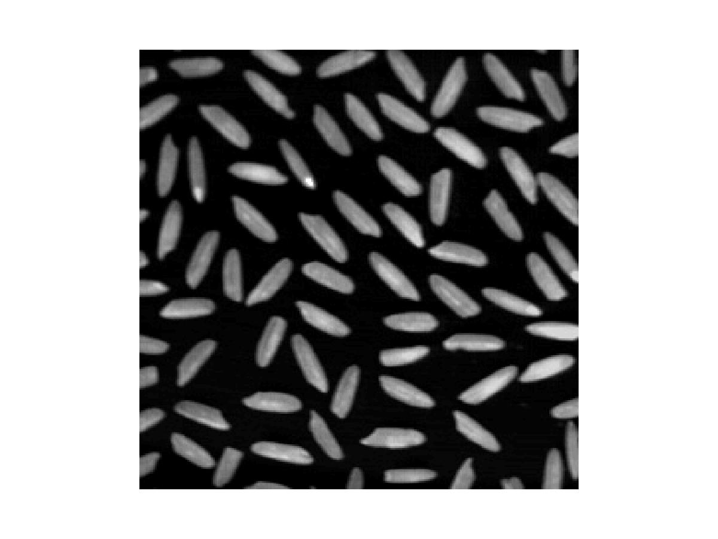
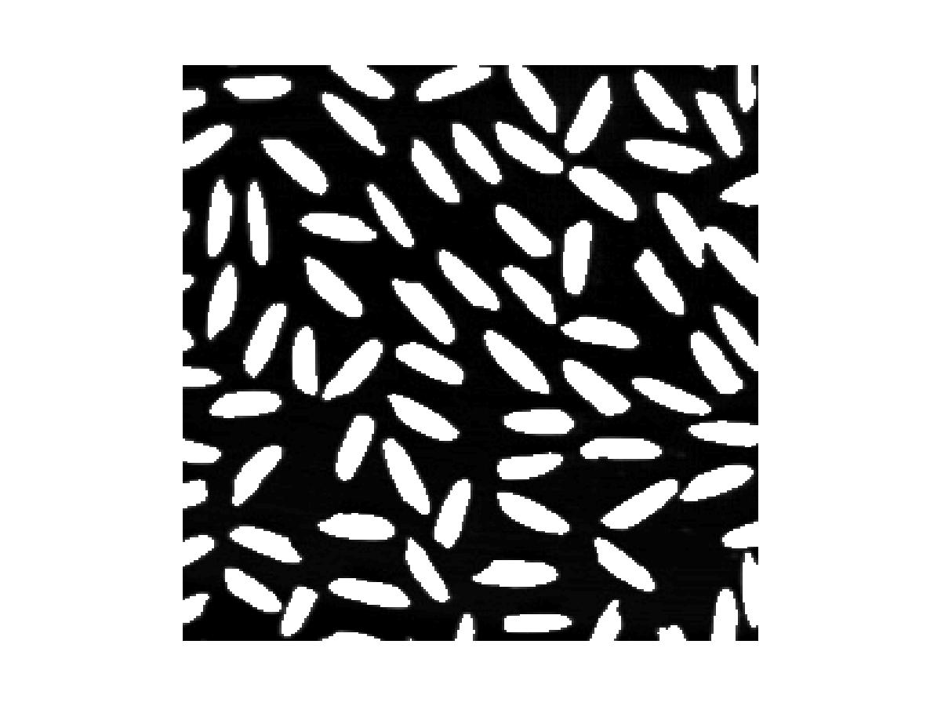
Gray Scale Image - bimodal
Image of rice with black background
Image after segmentation

Slide 22
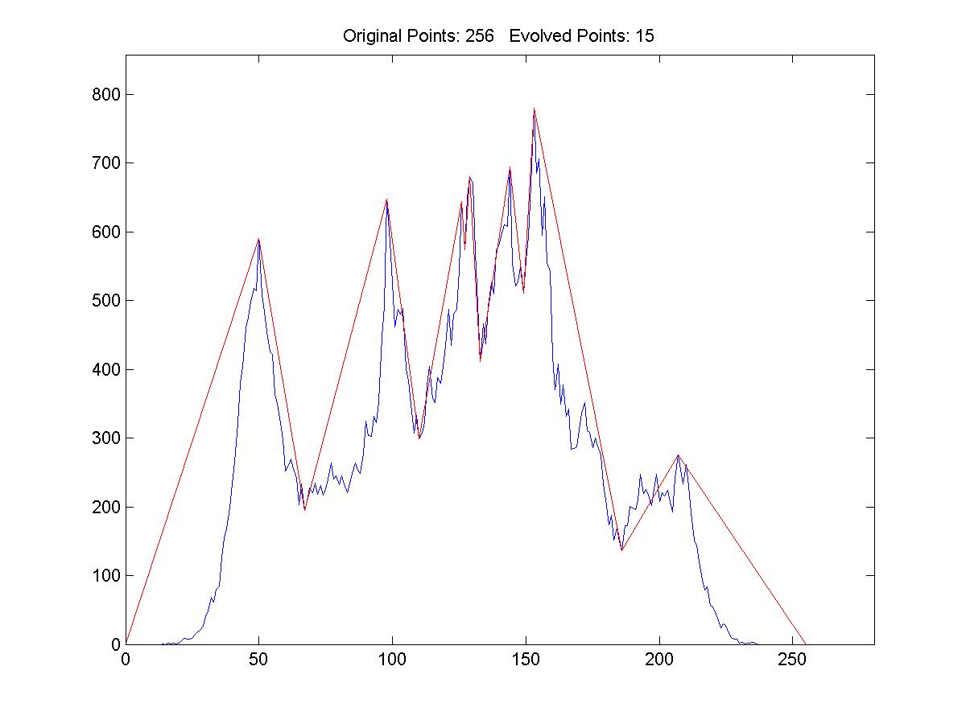
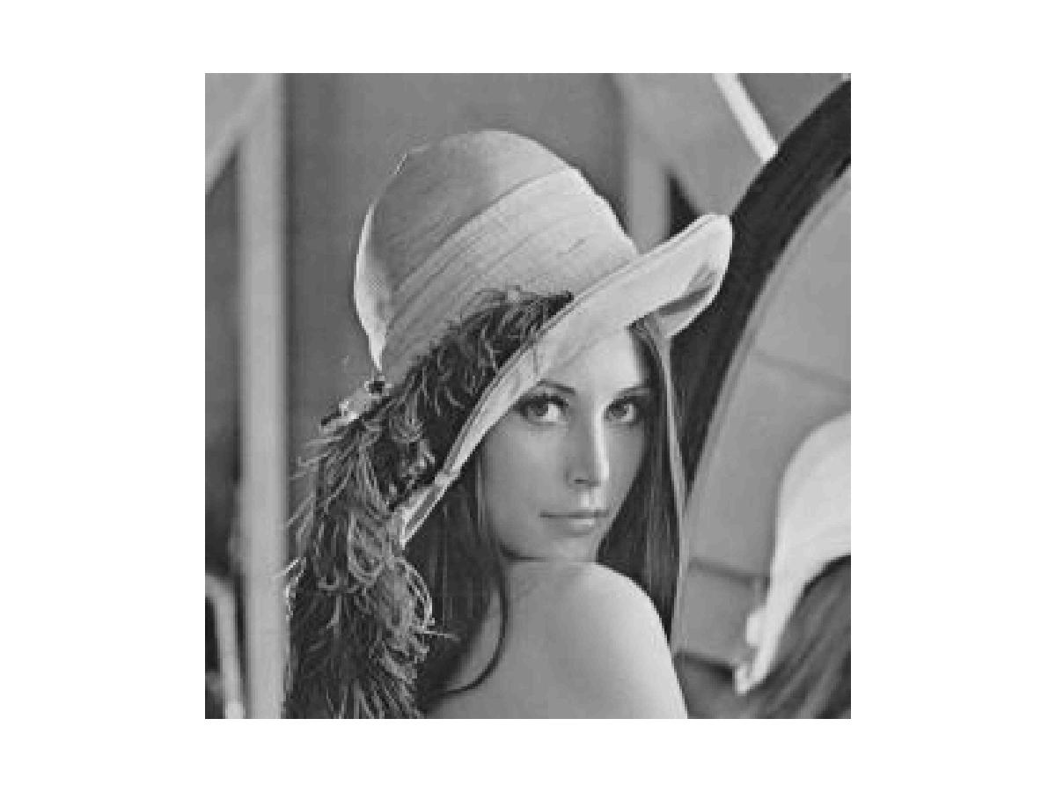
Thresholding multimodal histograms
The histogram is treated as a polyline and is simplified until a few vertices remain.
Thresholds are determined by vertices that are local minima.

Slide 23
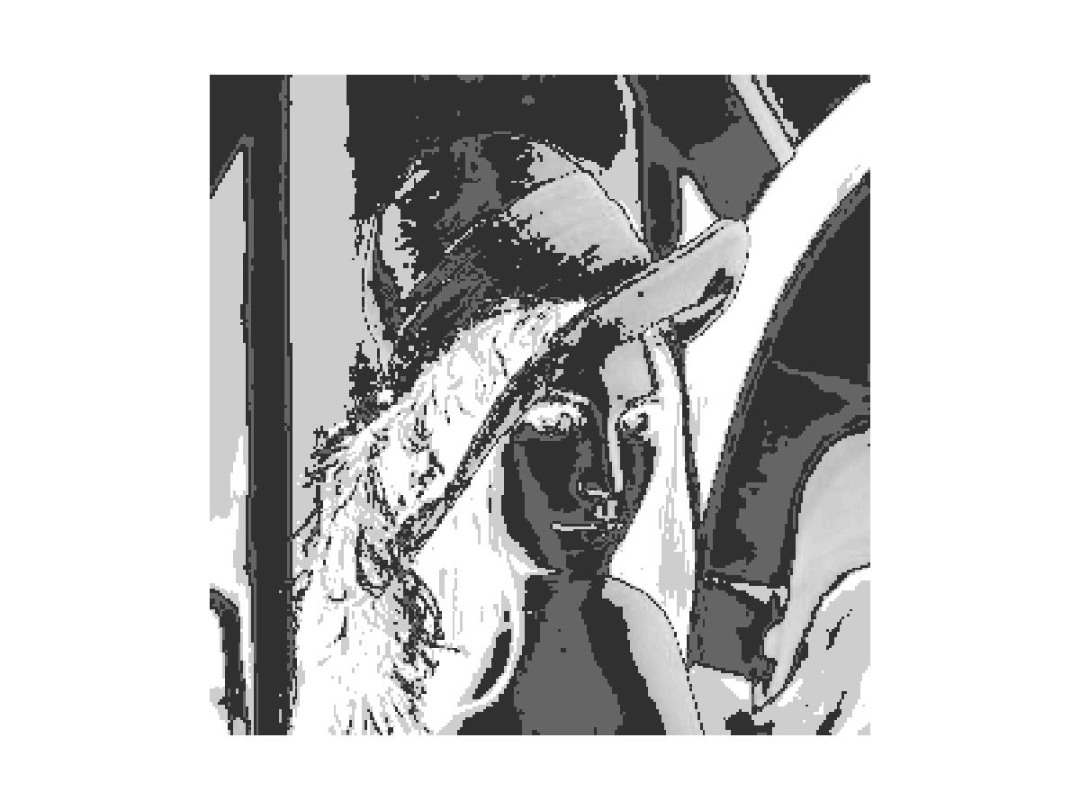
Segmented Image
Image after segmentation – we get a outline of her face, hat, shadow etc

Slide 24
Content
Introduction
Granularity/Hierarchy
The Goals of Segmentation
Segmentation by Thresholding
Region-Based Segmentation
Watershed Segmentation
Segmentation as Clustering
Discontinuity-based Method
Semantic Segmentation

Slide 25
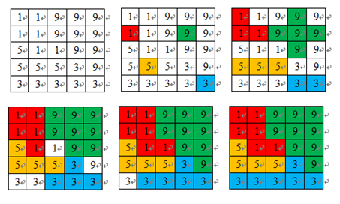
Region-Based Segmentation
Region Growing
Region growing is a procedure that groups pixels or subregions into larger regions.
The simplest of these approaches is pixel aggregation, which starts with a set of “seed” points and from these grows regions by appending to each seed points those neighboring pixels that have similar properties (such as gray level, texture, color, shape).

Slide 26
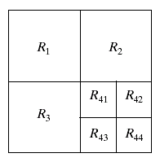
Region-Oriented Segmentation
Region Splitting
Region growing starts from a set of seed points.
An alternative is to start with the whole image as a single region and subdivide the regions that do not satisfy a condition of homogeneity.
Region Merging
Region merging is the opposite of region splitting.
Start with small regions (e.g. 2x2 or 4x4 regions) and merge the regions that have similar characteristics (such as gray level, variance).
Typically, splitting and merging approaches are used iteratively.

Slide 27

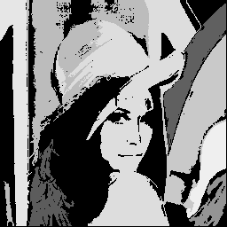
Results – Region grow

Slide 28
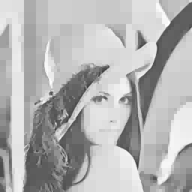
Results – Region Split

Slide 29
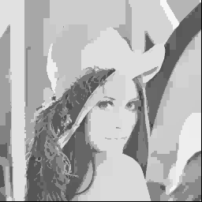
Results – Region Split and Merge

Slide 30
Content
Introduction
Granularity/Hierarchy
The Goals of Segmentation
Segmentation by Thresholding
Region-Based Segmentation
Watershed Segmentation
Segmentation as Clustering
Discontinuity-based Method
Semantic Segmentation

Slide 31
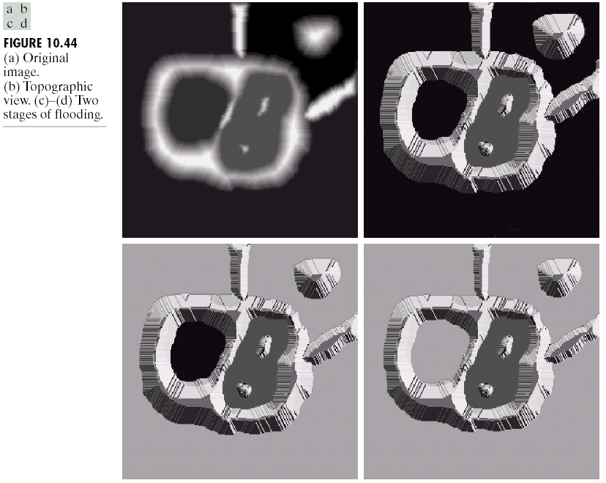
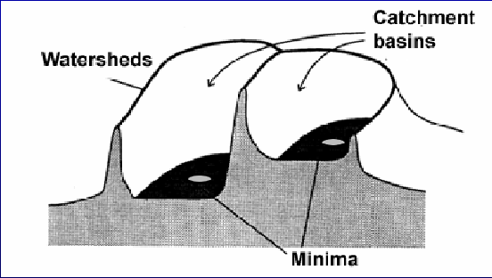
Watershed Segmentation
Visualize an image in 3D: spatial coordinates and gray levels.
In such a topographic interpretation, there are 3 types of points:
Points belonging to a regional minimum
Points at which a drop of water would fall to a single minimum. (→The catchment basin or watershed of that minimum.)
Points at which a drop of water would be equally likely to fall to more than one minimum. (→The divide lines or watershed lines.)
Watershed lines

Slide 32
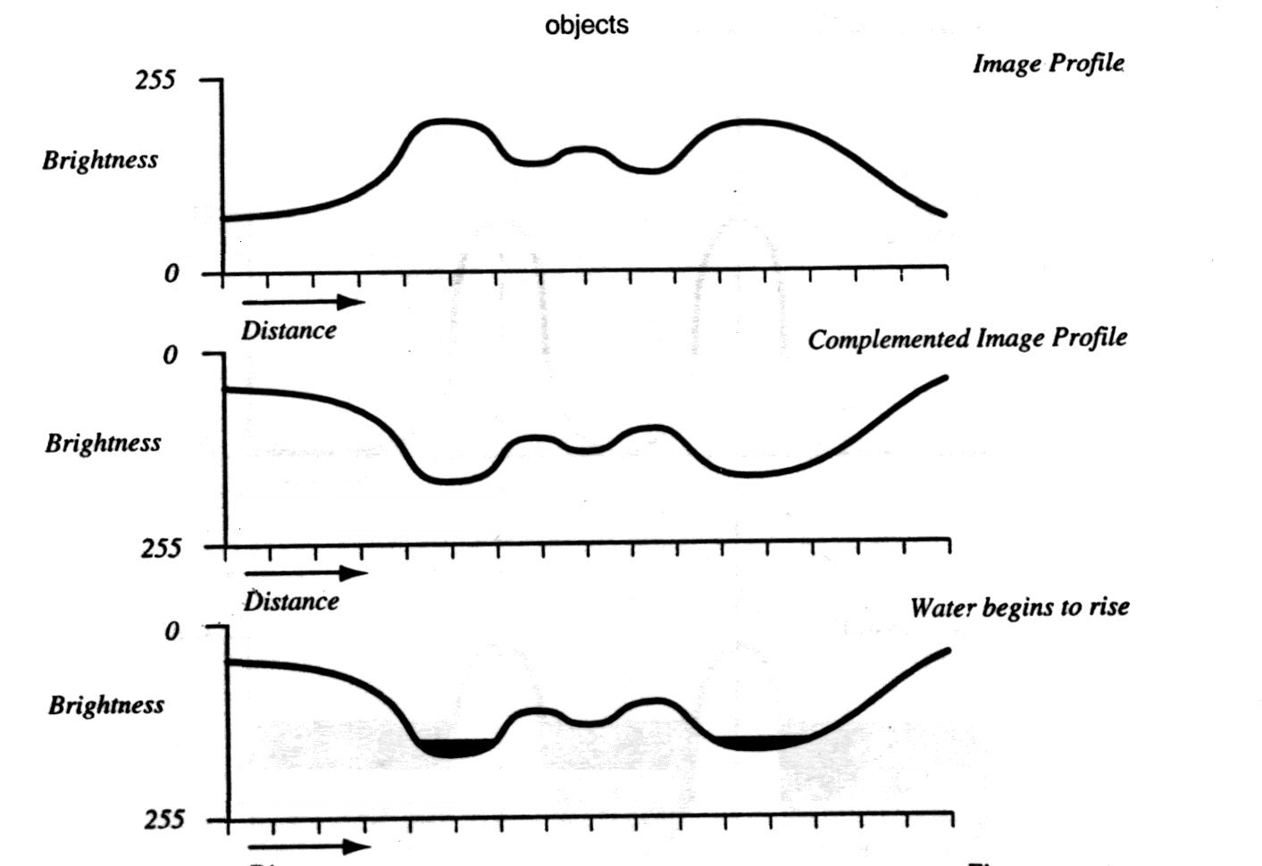
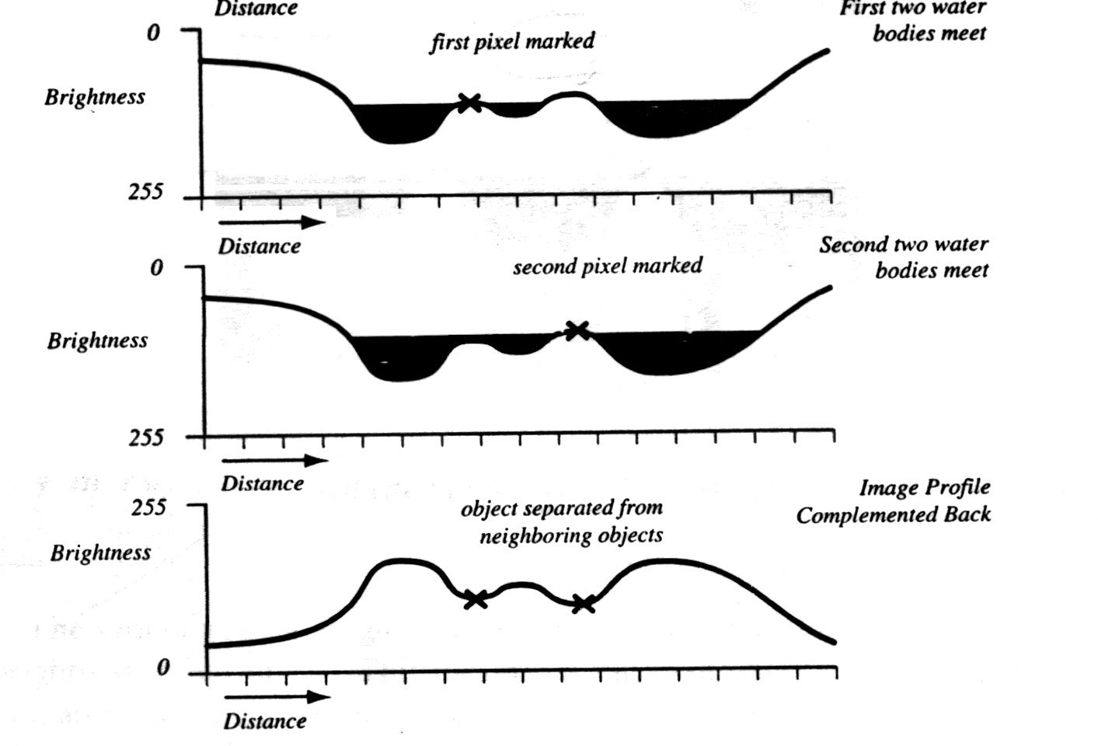
Watershed Segmentation
The objective is to find watershed lines.
The idea is simple:
Suppose that a hole is punched in each regional minimum and that the entire topography is flooded from below by letting water rise through the holes at a uniform rate.
When rising water in distinct catchment basins is about the merge, a dam is built to prevent merging. These dam boundaries correspond to the watershed lines.

Slide 33
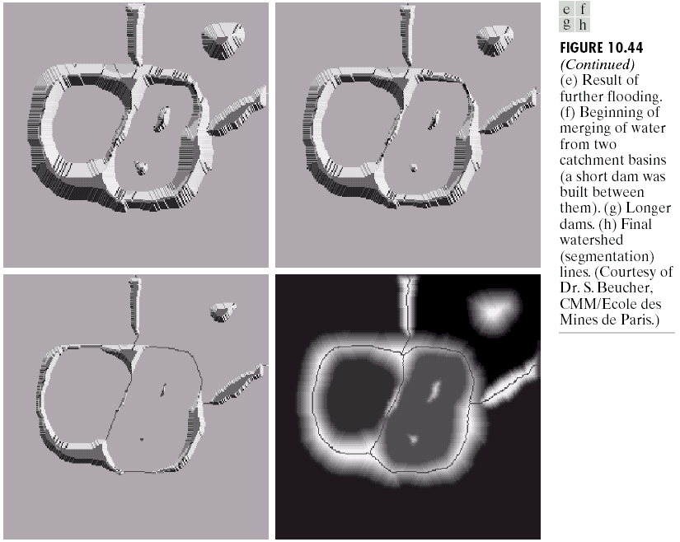
Watershed Segmentation

Slide 34
Watershed Segmentation
Start with all pixels with the lowest possible value.
These form the basis for initial watersheds
For each intensity level k:
For each group of pixels of intensity k
If adjacent to exactly one existing region, add these pixels to that region
Else if adjacent to more than one existing regions, mark as boundary
Else start a new region

Slide 35
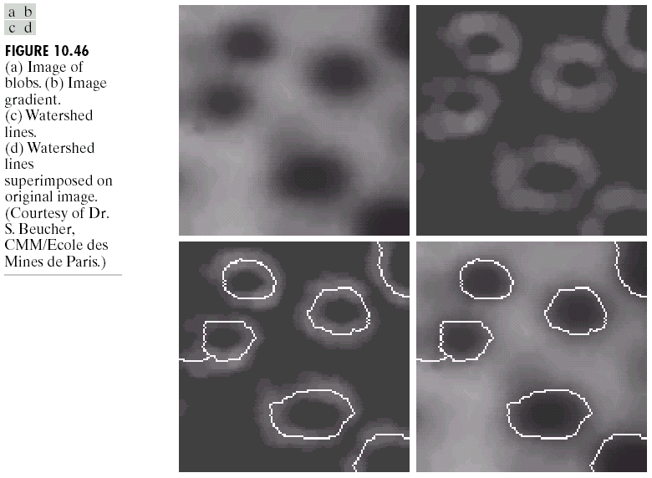
Watershed Segmentation
Watershed algorithm might be used on the gradient image instead of the original image.

Slide 36
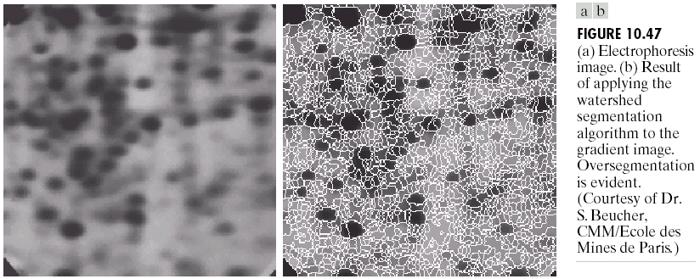
Watershed Segmentation
Due to noise and other local irregularities of the gradient, oversegmentation might occur.

Slide 37
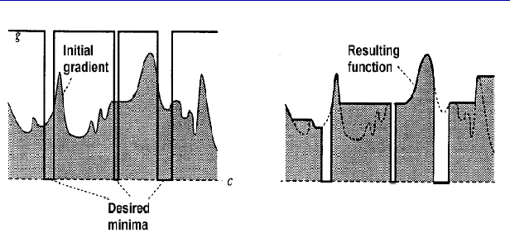
Watershed Segmentation
A solution is to limit the number of regional minima. Use markers to specify the only allowed regional minima.

Slide 38
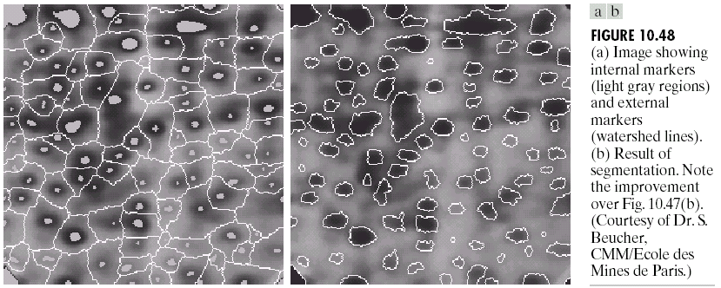
Watershed Segmentation
A solution is to limit the number of regional minima. Use markers to specify the only allowed regional minima. (For example, gray-level values might be used as a marker.)

Slide 39
Content
Introduction
Granularity/Hierarchy
The Goals of Segmentation
Segmentation by Thresholding
Region-Based Segmentation
Watershed Segmentation
Segmentation as Clustering
K-means clustering
Mean shift clustering
Graph partitioning/spectral clustering
Discontinuity-based Method
Semantic Segmentation

Slide 40
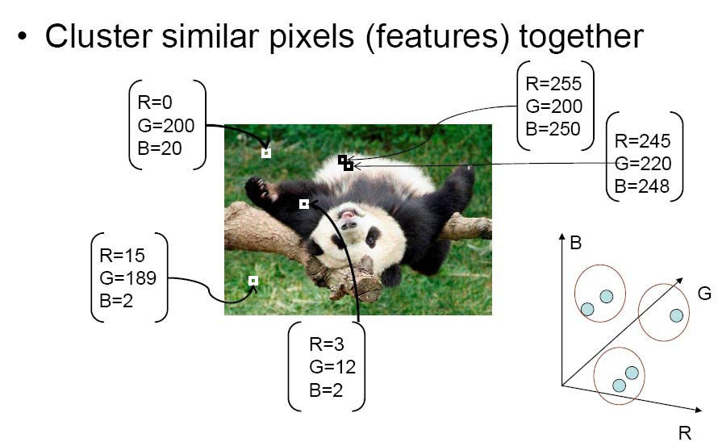
Segmentation as clustering
Source: K. Grauman

Slide 41
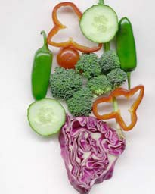
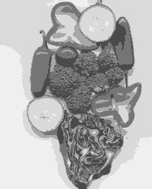
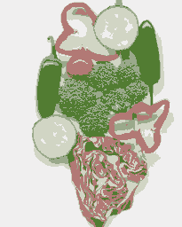
Segmentation as clustering
K-means clustering based on intensity or color is essentially vector quantization of the image attributes
Clusters don’t have to be spatially coherent
Image
Intensity-based clusters
Color-based clusters

Slide 42
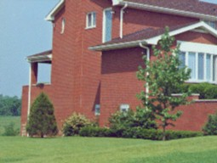
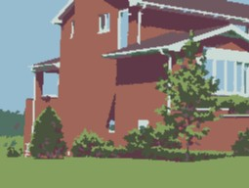
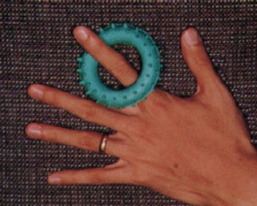

Segmentation as clustering

Slide 43
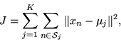
Clustering via K-Means Algorithm
An algorithm for partitioning (or clustering) N data points
into K disjoint subsets S_{j} containing N_{j} data points so as to
minimize the sum-of-squares criterion
data points
centroid

Slide 44
Subproblem I: Clustering by distance to known centers

Slide 45
Subproblem II: Finding the centers from known clustering

Slide 46
Clustering via K-Means Algorithm
An algorithm for partitioning (or clustering) N data points
into K disjoint subsets S_{j} containing N_{j} data points so as to
minimize the sum-of-squares criterion
data points
centroid
Initialization: randomly choose
K centroids
the data points are assigned to the K sets
the centroid is updated for each set

Slide 47
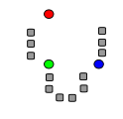
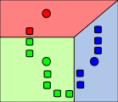
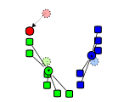
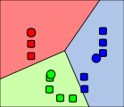
Toy Example of Kmeans Clustering
1.Initialization
2.NN-Clustering
3.Codeword-update
4. Alternate 2 and 3
until convergence
http://home.dei.polimi.it/matteucc/Clustering/tutorial_html/AppletKM.html

Slide 48
K-means Clustering: Step 1
Algorithm: k-means, Distance Metric: Euclidean Distance
5
4
k₁
3
k₂
2
1
k₃
0
0
1
2
3
4
5

Slide 49
K-means Clustering: Step 2
Algorithm: k-means, Distance Metric: Euclidean Distance
5
4
k₁
3
k₂
2
1
k₃
0
0
1
2
3
4
5

Slide 50
K-means Clustering: Step 3
Algorithm: k-means, Distance Metric: Euclidean Distance
5
4
k₁
3
2
k₃
k₂
1
0
0
1
2
3
4
5

Slide 51
K-means Clustering: Step 4
Algorithm: k-means, Distance Metric: Euclidean Distance
5
4
k₁
3
2
k₃
k₂
1
0
0
1
2
3
4
5

Slide 52
K-means Clustering: Step 5
Algorithm: k-means, Distance Metric: Euclidean Distance
k₁
k₂
k₃

Slide 53
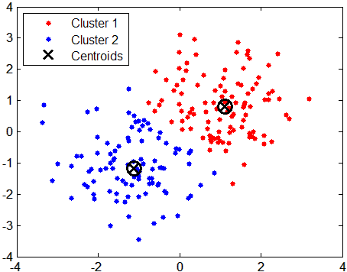
Data Clustering via Kmeans
Instead of 2D, kmeans can be applied to 3D color space RGB or L*a*b*

Slide 54
K-means Properties
Works best when clusters are spherical (blob like)
Fails for elongated clusters
SSE is not an appropriate objective function in this case
Sensitive to outliers

Slide 55
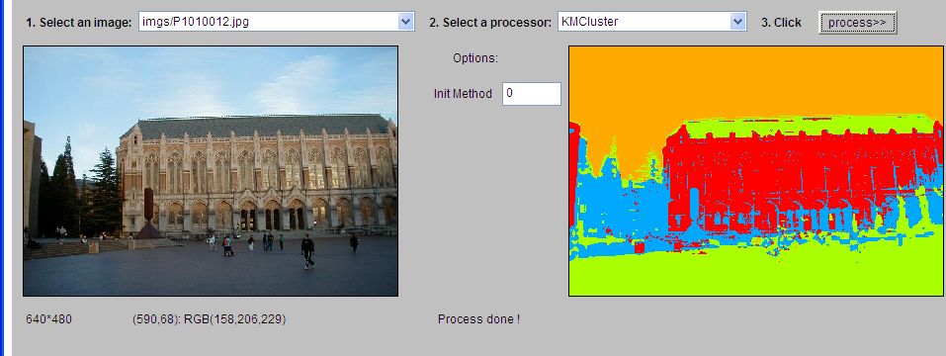
K-Means Example 1

Slide 56

K-Means Example 2

Slide 57

K-Means Example 3

Slide 58



K-means clustering examples: Superpixels
Apply K-means to RGBXY features
[SLIC superpixels, Achanta et al., PAMI 2011]

Slide 59







K-means clustering examples: Texture Analysis
responses to N filters (convolution)
K-means
for points in R^{N}
instead of R³
slide from Naotoshi Seo
coordinates of patch P_{p} at p w.r.t. basis vectors F
(if filters F are orthonormal)
…..
F - bank of N filters for texture, e.g. Gabor filters

Slide 60
Content
Introduction
Granularity/Hierarchy
The Goals of Segmentation
Segmentation by Thresholding
Region-Based Segmentation
Watershed Segmentation
Segmentation as Clustering
K-means clustering
Mean shift clustering
Graph partitioning/spectral clustering
Discontinuity-based Method
Semantic Segmentation

Slide 61

Mean shift clustering and segmentation
An advanced and versatile technique for clustering-based segmentation
http://www.caip.rutgers.edu/~comanici/MSPAMI/msPamiResults.html
D. Comaniciu and P. Meer, Mean Shift: A Robust Approach toward Feature Space Analysis, PAMI 2002.

Slide 62

Mean shift algorithm
The mean shift algorithm seeks modes or local maxima of density in the feature space
Feature space (L*u*v* color values)
image

Slide 63

Mean shift
Search window
Center of mass
Mean Shift vector
Slide by Y. Ukrainitz & B. Sarel

Slide 64
Mean shift
Search window
Center of mass
Mean Shift vector
Slide by Y. Ukrainitz & B. Sarel

Slide 65
Mean shift
Search window
Center of mass
Mean Shift vector
Slide by Y. Ukrainitz & B. Sarel

Slide 66
Mean shift
Search window
Center of mass
Mean Shift vector
Slide by Y. Ukrainitz & B. Sarel

Slide 67
Mean shift
Search window
Center of mass
Mean Shift vector
Slide by Y. Ukrainitz & B. Sarel

Slide 68
Mean shift
Search window
Center of mass
Slide by Y. Ukrainitz & B. Sarel

Slide 69


Mean shift clustering
Cluster: all data points in the attraction basin of a mode
Attraction basin: the region for which all trajectories lead to the same mode
Slide by Y. Ukrainitz & B. Sarel

Slide 70


Mean shift clustering/segmentation
Find features (color, gradients, texture, etc)
Initialize windows at individual feature points
Perform mean shift for each window until convergence
Merge windows that end up near the same “peak” or mode

Slide 71




Mean shift segmentation results
http://www.caip.rutgers.edu/~comanici/MSPAMI/msPamiResults.html

Slide 72

More results

Slide 73


More results

Slide 74
Content
Introduction
Granularity/Hierarchy
The Goals of Segmentation
Segmentation by Thresholding
Region-Based Segmentation
Watershed Segmentation
Segmentation as Clustering
K-means clustering
Mean shift clustering
Graph partitioning/spectral clustering
Discontinuity-based Method
Semantic Segmentation

Slide 75


Images as graphs
j
^{w}ij
i
Node for every pixel
Edge between every pair of pixels (or every pair of “sufficiently close” pixels)
Each edge is weighted by the affinity or similarity of the two nodes
Source: S. Seitz

Slide 76

Graph cut
B
A
Set of edges whose removal makes a graph disconnected
Cost of a cut: sum of weights of cut edges
A graph cut gives us a segmentation
What is a “good” graph cut and how do we find one?
Source: S. Seitz

Slide 77

Minimum cut
We can do segmentation by finding the
minimum cut in a graph
Efficient algorithms exist for doing this
Minimum cut example

Slide 78

Minimum cut
We can do segmentation by finding the
minimum cut in a graph
Efficient algorithms exist for doing this
Minimum cut example

Slide 79




Slide 80





Properties of Graph Laplacian
q₁
q₂
w_{ij} =

Slide 81


Slide 82

j
^{w}ij
i
Node for every pixel
Edge between every pair of pixels (or every pair of “sufficiently close” pixels)
Each edge is weighted by the affinity or similarity of the two nodes
Source: S. Seitz

Slide 83


Slide 84









Example results

Slide 85









Results: Berkeley Segmentation Engine
http://www.cs.berkeley.edu/~fowlkes/BSE/

Slide 86
Content
Introduction
Granularity/Hierarchy
The Goals of Segmentation
Segmentation by Thresholding
Region-Based Segmentation
Watershed Segmentation
Segmentation as Clustering
Discontinuity-based Method
Semantic Segmentation

Slide 87

Detection of Discontinuities
detect the three basic types of gray-level discontinuities
points , lines , edges
the common way is to run a mask through the image

Slide 88
Discontinuity-based Method
Detection of discontinuities
Point detection
Line detection
Edge detection
Edge linking and boundary detection

Slide 89

Point Detection
a point has been detected at the location on which the mask is centered if
|R| ≥ T
where
T is a nonnegative threshold
R is the sum of products of the coefficients with the gray levels contained in the region encompassed by the mask.
R = w₁ z₁ + w₁₂ z₁₂ +…+w₉ z₉ =
Notes:
看一下这个mask的特性

Slide 90
Point Detection
Note that the mask is the same as the mask of Laplacian Operation (in chapter 3)
The only differences that are considered of interest are those large enough (as determined by T) to be considered isolated points.
|R| ≥ T
Notes:
该mask与拉普拉斯变化的mask，但是这里的检测是需要加一个阈值进一步过滤。

Slide 91

Example
Notes:
(b) X-ray image of a turbine blade with a porosity. (带有通孔的涡轮叶片的X射线图)

Slide 92
Discontinuity-based Method
Detection of discontinuities
Point detection
Line detection
Edge detection
Edge linking and boundary detection

Slide 93

Line Detection
Horizontal mask will result with max response when a line passed through the middle row of the mask with a constant background.
the similar idea is used with other masks.
note: the preferred direction of each mask is weighted with a larger coefficient (i.e.,2) than other possible directions.
Notes:
多方向模板

Slide 94
Line Detection
Apply every masks on the image
let R1, R2, R3, R4 denotes the response of the horizontal, +45 degree, vertical and -45 degree masks, respectively.
if, at a certain point in the image
|R_{i}| > |R_{j}|,
for all j≠i, that point is said to be more likely associated with a line in the direction of mask i.

Slide 95
Line Detection
Alternatively, if we are interested in detecting all lines in an image in the direction defined by a given mask, we simply run the mask through the image and threshold the absolute value of the result.
The points that are left are the strongest responses, which, for lines one pixel thick, correspond closest to the direction defined by the mask.

Slide 96

Example

Slide 97
Discontinuity-based Method
Detection of discontinuities
Point detection
Line detection
Edge detection
Edge linking and boundary detection

Slide 98
Edge Detection
the most common approach for detecting meaningful discontinuities in gray level.
we discuss approaches for implementing
first-order derivative (Gradient operator)
second-order derivative (Laplacian operator)
Here, we will talk only about their properties for edge detection.

Slide 99
Basic Formulation
an edge is a set of connected pixels that lie on the boundary between two regions.
an edge is a “local” concept whereas a region boundary, owing to the way it is defined, is a more global idea.

Slide 100

Ideal and Ramp Edges
because of optics, sampling, image acquisition imperfection
Notes:
ramp edge; (渐变边缘, 斜坡边缘)

Slide 101
Thick edge
The slope of the ramp is inversely proportional to the degree of blurring in the edge.
We no longer have a thin (one pixel thick) path.
Instead, an edge point now is any point contained in the ramp, and an edge would then be a set of such points that are connected.
The thickness is determined by the length of the ramp.
The length is determined by the slope, which is in turn determined by the degree of blurring.
Blurred edges tend to be thick and sharp edges tend to be thin

Slide 102


Notes:
这是常见的三种边缘：ramp，step，and roof
step通常指很快速的边缘变化。理想情况下，是一个像素宽度，常见于理想的模型边缘（计算机生成的）
但是一般计算机成像过程总会引入模糊 ，这时会产生ramp的边缘
roof代表区域中有一条线通过，长度由roof的底宽度决定。

Slide 103

First and Second derivatives
the signs of the derivatives would be reversed for an edge that transitions from light to dark
Notes:
Gray-level profile 灰度级剖面图

Slide 104
Second derivatives
produces 2 values for every edge in an image (an undesirable feature)
an imaginary straight line joining the extreme positive and negative values of the second derivative would cross zero near the midpoint of the edge. (zero-crossing property)

Slide 105
Zero-crossing
quite useful for locating the centers of thick edges
we will talk about it again later

Slide 106


Noise Images
First column: images and gray-level profiles of a ramp edge corrupted by random Gaussian noise of mean 0 and σ = 0.0, 0.1, 1.0 and 10.0, respectively.
Second column: first-derivative images and gray-level profiles.
Third column : second-derivative images and gray-level profiles.
These examples are good illustrations of the sensitivity of derivatives to noise. The extent of second derivative is beyond the first derivative.

Slide 107
Keep in mind
fairly little noise can have such a significant impact on the two key derivatives used for edge detection in images
image smoothing should be serious consideration prior to the use of derivatives in applications where noise is likely to be present.

Slide 108
First derivative: gradient operators
Roberts cross-gradient operators
Prewitt operators
Sobel operators
Where, Prewitt mask is more simpler to implement than the Sobel

Slide 109

Gradient Masks
Notes:
三个mask，在两个方向上计算gx，gy

Slide 110

Diagonal edges with Prewitt and Sobel masks
Sobel masks have slightly superior noise-suppression characteristics which is an important issue when dealing with derivatives.

Slide 111
Notes:
Perpendicular 垂直

Slide 112

Example
Illustration of the gradient and its components

Slide 113

Example
For reduce the contribution of image detail (such as wall bricks) to edges, image-averaging is needed before computing gradient.

Slide 114

Example
Notes:
使用对角线检测mask

Slide 115

Second derivative: Laplacian operators
Laplacian operator
(linear operator)
Notes:
具体推倒过程请看p715 公式2-1，2-2
左边模板，考虑的是x和y方向上的变化，右边的mask是考虑了八邻域的像素取值

Slide 116
Second derivative: Laplacian operators
Several reasons that Laplacian generally is not used in its original form for edge detection:
(1) The Laplacian is unacceptably sensitive to noise;
(2) The magnitude of the Laplacian produces double edges, an undesirable effect because it complicates segmentation;
(3) unable to detect edge direction

Slide 117
Second derivative: Laplacian operators
For this reasons, the role of the Laplacian in segmentation includes:
(1) Using its zero-crossing property for edge detection;
(2) Using it help to determine whether a pixel is on the dark or light side of an edge.
In the role of first category, the Laplacian is combined with smoothing as a precursor to finding edges via zero-crossing.

Slide 118
Laplacian of Gaussian (LoG)
Gaussian function:
Convolving this function with an image blurs the image (can reduced the effect of noise), with the degree of blurring being determined by the value of σ
where r² = x²+y², and
σ is the standard deviation
Notes:
使用LOG的两个出发点：
-该mask具有滤波效应，可以在边缘检测同时进行平滑，减少噪声影响
-一阶导数的mask虽然简单，但是对于方向性敏感，因此需要运行多个mask，并且对于旋转敏感
二阶导数对于方向不敏感

Slide 119
Laplacian of Gaussian (LoG)
Laplacian combined with smoothing as a precursor to find edges via zero-crossing.
Laplacian of a Gaussian (LoG, is also called Mexican hat function), The purpose of LoG is to provide an image with zero crossing used to establish the location of edges.
where r² = x²+y², and σ is the standard deviation
Notes:
precursor 先锋/预处理

Slide 120

Mexican hat
positive central term
surrounded by an adjacent negative region (a function of distance)
zero outer region
The graph of LoG
the coefficient must be sum to zero

Slide 121
Linear Operation
second derivation is a linear operation
thus, ∇²f is the same as convolving the image with Gaussian smoothing function first and then computing the Laplacian of the result
Notes:
LoG是一个线性操作的过程，所以理论上可以先滤波再求拉普拉斯算子

Slide 122


Example
a). Original image
b). Sobel Gradient
c). Spatial Gaussian smoothing function
d). Laplacian mask
e). LoG
f). Threshold LoG
g). Zero crossing

Slide 123
Zero crossing & LoG
Approximate the zero crossing from LoG image
to threshold the LoG image by setting all its positive values to white and all negative values to black.
the zero crossing occur between positive and negative values of the thresholded LoG.

Slide 124
Zero crossing vs. Gradient
Attractive
Zero crossing produces thinner edges
Noise reduction
Drawbacks
Zero crossing creates closed loops. (spaghetti effect)
sophisticated computation.
Gradient is more frequently used.

Slide 125
Discontinuity-based Method
Detection of discontinuities
Point detection
Line detection
Edge detection
Edge linking and boundary detection

Slide 126
Edge Linking and Boundary Detection
edge detection algorithm are followed by linking procedures to assemble edge pixels into meaningful edges.
Basic approaches
Local Processing
Global Processing via the Hough Transform
Global Processing via Graph-Theoretic Techniques
Notes:
-一般边缘检测算法后续会跟随边缘连接算法，形成有意义的边缘

Slide 127
Local Processing
analyze the characteristics of pixels in a small neighborhood (say, 3x3, 5x5) about every edge pixels (x,y) in an image.
all points that are similar according to a set of predefined criteria are linked, forming an edge of pixels that share those criteria.
Notes:
-在局部小区域内分析边缘像素的特性
-按照准则，看是否要进行边缘的连接。

Slide 128
Criteria
the strength of the response of the gradient operator used to produce the edge pixel
an edge pixel with coordinates (x₀,y₀) in a predefined neighborhood of (x,y) is similar in magnitude to the pixel at (x,y) if
|∇f(x,y) - ∇f (x₀,y₀) | ≤ E
Notes:
梯度值相近

Slide 129
Criteria
the direction of the gradient vector
an edge pixel with coordinates (x₀,y₀) in a predefined neighborhood of (x,y) is similar in angle to the pixel at (x,y) if
|α(x,y) - α (x₀,y₀) | < A
Notes:
梯度方向相近

Slide 130
Criteria
A point in the predefined neighborhood of (x,y) is linked to the pixel at (x,y) if both magnitude and direction criteria are satified.
the process is repeated at every location in the image
a record must be kept
simply by assigning a different gray level to each set of linked edge pixels.
Notes:
两个条件都满足后，可以给这些特殊的点赋予一个特殊的值

Slide 131

Example
find rectangles whose sizes makes them suitable candidates for license plates
use horizontal and vertical Sobel operators
eliminate isolated short segments
link conditions:
gradient value > 25
gradient direction differs < 15°

Slide 132

Hough Transformation (Line)
xy-plane
ab-plane or parameter space
y_{i} =ax_{i} + b
b = - ax_{i} + y_{i}
all points (x_{i} ,y_{i}) contained on the same line must have lines in parameter space that intersect at (a’,b’)

Slide 133


Accumulator cells
(a_{max}, a_{min}) and (b_{max}, b_{min}) are the expected ranges of slope and intercept values.
all are initialized to zero
if a choice of a_{p} results in solution b_{q} then we let A(p,q) = A(p,q)+1
at the end of the procedure, value Q in A(i,j) corresponds to Q points in the xy-plane lying on the line y = a_{i}x+b_{j}
b = - ax_{i} + y_{i}

Slide 134

ρθ-plane
ρθ-plane
x cos θ+ y sin θ= ρ
= ±90° measured with respect to x-axis
problem of using equation y = ax + b is that value of a is infinite for a vertical line.
To avoid the problem, use equation x cos θ+ y sin θ = ρ to represent a line instead.
vertical line has θ = 90° with ρ equals to the positive y-intercept or θ = -90° with ρ equals to the negative y-intercept
Notes:
intercept 截距

Slide 135
Generalized Hough Transformation
can be used for any function of the form
g(v,c) = 0
v is a vector of coordinates
c is a vector of coefficients

Slide 136
Hough Transformation (Circle)
Quiz: Write down the process of estimating a circle in an image using Hough transformation.
equation:
(x-c₁)² + (y-c₂)² = c₃²

Slide 137
Hough Transformation (Circle)
equation:
(x-c₁)² + (y-c₂)² = c₃²
three parameters (c₁, c₂, c₃)
cube like cells
accumulators of the form A(i, j, k)
increment c₁ and c₂ , solve of c₃ that satisfies the equation
update the accumulator corresponding to the cell associated with triplet (c₁, c₂, c₃)

Slide 138
Edge-linking based on Hough Transformation
Compute the gradient of an image and threshold it to obtain a binary image.
Specify subdivisions in the ρθ-plane.
Examine the counts of the accumulator cells for high pixel concentrations.
Examine the relationship (principally for continuity) between pixels in a chosen cell.
Notes:
对于哈夫变化的过程总结。

Slide 139
Continuity
based on computing the distance between disconnected pixels identified during traversal of the set of pixels corresponding to a given accumulator cell.
a gap at any point is significant if the distance between that point and its closet neighbor exceeds a certain threshold.
Notes:
在连接的时候要考虑点和点之间的距离，当距离超过一定阈值的时候，不连接为一条直线

Slide 140

Notes:
-a 航拍图像

Slide 141
Content
Introduction
Granularity/Hierarchy
The Goals of Segmentation
Segmentation by Thresholding
Region-Based Segmentation
Watershed Segmentation
Segmentation as Clustering
Discontinuity-based Method
Semantic Segmentation

Slide 142



Torr Vision Group, Engineering Department
Semantic Segmentation
Recognizing and delineating objects in an image →
Classifying each pixel in the image

Slide 143

Torr Vision Group, Engineering Department
Live Demo - http://crfasrnn.torr.vision/

Slide 144






Semantic Segmentation
Torr Vision Group, Engineering Department
FCN
CRF-RNN

Slide 145






Experiments
Torr Vision Group, Engineering Department
FCN
CRF
FCN
CRF- RNN
FCN
[Long et al, 2014]
[Chen et al, 2015]
Ours
68.3
69.5
72.9

Slide 146

Tricky examples
Torr Vision Group, Engineering Department
http://i.huffpost.com/gen/1478236/thumbs/s-DIRD6-large640.jpg

Slide 147
End

